Slide 1
Forest Presentation

Slide 2
Overview
We decided to make an application to simulate tree growth over a plot of land to help with optimizing the growth of trees based on their placement as we were able to find the following findings that suggest that deforestation is an issue within the uk.

Slide 3
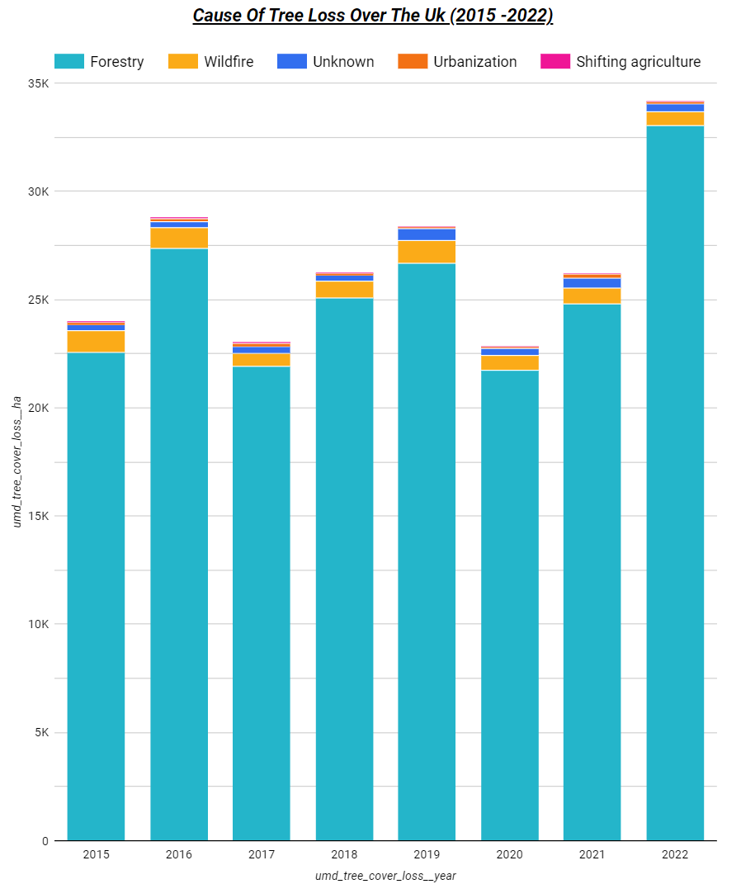
Findings
From our research we were able to identify the increasing loss of trees over the uk was an actual as the tree loss trend seemed to be positive.

Slide 4
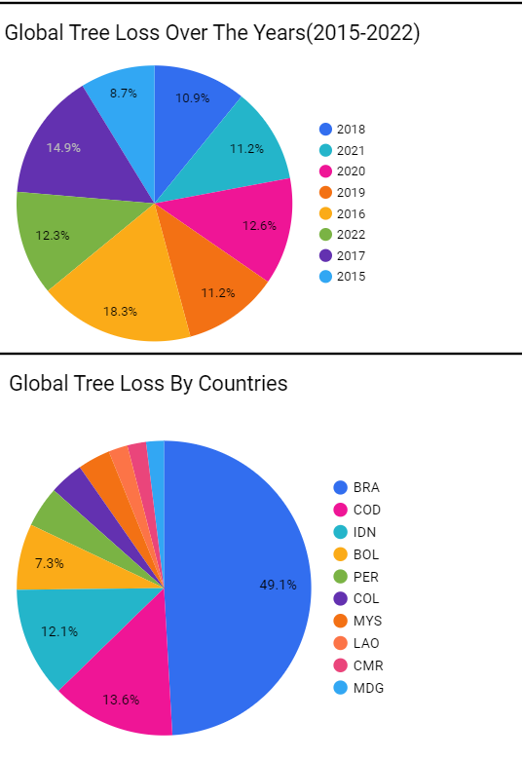
Findings
When we compare the uk’s positive trend in tree loss to the rest of the world we can see that the trend isn’t shared as there’s more so of a negative trend displayed by more earlier years in the range 2016 -2022 taking up more of the pie chart.
Which is surprising when you add the context that compared to other countries the uk tree loss isn’t that significant as it isn’t even capable of being displayed on the pie chart in comparison to some other countries.

